Slide 1
Advanced Level Practice
4 pillars
Clinical – Education- Research- Management/Leadership

Slide 2
Session Aim
Overview of Advanced Level Practice
Specifically,
  Emergence of the professional role and professional dimensions
  Concept Advanced Level Practice Domains & Attributes……expectations
  Consider foreground regarding current debate, challenges and role implications

Slide 3
Contextual Background
Advancing Level Practice (ALP) not a new phenomenon – traditionally aimed at Clinical pillar
Professional evolution is not well documented, remains diffuse term….. inconsistently applied
Internationally recognised
  USA, Australia
UK Emerged due to local demands
  1980-90s…extended roles mainly in primary care
  Increased service demands - acute admissions – work time directive to reduce Drs in training working hours

Slide 4
Contextual Drivers
Change in population demographics
  Aging population
  LTC, Multiple Morbidity, Public Health imperatives
  Health care needs, service development..?
  Public expectations……?

Slide 5
Contextual Drivers
ALP key socio economic driver
What has become evident is….
Extended, Expanded, Developed roles become part of the infrastructure
ALP is not a job description or regulated title
Regarded as a ‘level of practice’ – now accepted as MSc level academic qualification with specialist at PGCert/Diploma

Slide 6
Contextual Drivers
Responsiveness…. changing face of healthcare in terms of challenges and vision
Beneficial to prioritising patients and care delivery in context of adopted roles
Political agenda
  Better Health better Care (SG 2007)
  Shifting the balance of care (SG 2009)
  Quality Strategy (SG 2010)
  Public Bodies (Joint Working) Act (2014)
  Review OOH Primary Care – Unscheduled Care (2015)
  Transforming Roles Advanced Nurse Practitioners (2016)
  Paramedic changes to roles (SAS, 2020 Vision)
  Many English Health Education England policies due out in next year setting the direction for advanced practice
  Need at the moment is focussed on clinical pillar of advanced practice in most UK countries

Slide 7
External and Internal Drivers
GP shortage, European Working Time Directive, changing roles of practitioners
Shifting working patterns – particularly in nursing: junior doctors EWTD
In parallel, professions extending role demarcations;
  skill mix
Professional tribalism
  Mixed responses – medical/nursing/paramedic

Slide 8
Association of Advance Practice Educators UK
http://aape.org.uk/
Follow on twitter @aapeuk

Slide 9
Current Debates within ALP
Changing organisation face and structure of healthcare delivery
Professional regulation and governance of ALP

Slide 10
Describing Advanced Practice
Within some professions ….confusion and ambiguity
Often defined as ‘practice’ which is beyond basic level (Dowling et al. 2013)
Meaning…..inference of Level of Practice

Slide 11
The Nursing Example
UKCC
  defined and set the standard for Specialist Practice 1998, 2001 ‘high level judgment, discernment and decision making’
  Advanced Practice - undetermined, a caveat to develop opportunity of ‘advancing’ their practice
NMC (2005) defined Advanced Practice – specific skill in diagnosis
  Proposed a sub part of the register to regulate

Slide 12
Paramedic Example
Advanced Paramedic ‘AP’
- Role in See-Rx-Manage-discharge/refer
- Expectation to be practicing all 4 pillars of advanced practice
- leadership and development of the role
Specialist Paramedic
  - Role in See-Rx-Manage-discharge/refer
Professional stance……….. HPC?

Slide 13
Wider Professional Issues
Proposal rejected based on report by the Council for Healthcare Regulatory Excellence 2010
  Advanced practice = career development
  Activities do not lie out with the scope of initial registration
  Risk managed within current professional code e.g. NMC/HCPC
  Need for nationally agreed standards to support local governance arrangements

Slide 14
Professional Governance
Implications ….to date
  No agreed core competencies
  No prescribed standardised national educational pathway, under development/modification
Governance of AP and its development occurring at a local level…..variation (within different healthcare trusts and different geographical areas)
? Driven by the knowledge that regulation would be costly
Proliferation of titles

Slide 15
Profusion of Titles
Advanced Nurse Practitioner
Advanced Practitioner
Emergency Nurse Practitioner
Advanced Practice Nurse
Nurse Consultant
Advanced Midwife
Advanced Practice Practitioner
Advanced Paramedic
Specialist Paramedic
Paramedic Practitioner
Senior Paramedic
…………………….all unregulated

Slide 16
Professional Governance
Council for Healthcare Regulatory Excellence (CHRE) …APs present no greater risk than newly qualified registrants
Questions raised regarding ‘competency’ to operate at this level of practice
Evidence suggest ‘low risk’ with positive patient experiences and outcomes

Slide 17
Disquiet
ANP actively seeking Professional regulation
Argue that the aim is not to govern risk, acknowledge level of practice ….some similarly to other nursing disciplines i.e. SCPHN (Specialist community public health nursing)
Register to recognise contribution based on competencies and level of care provided

Slide 18
Local Governance….Scotland
Health Devolved - Nursing perspective – NMC
                Scottish Ambulance Service
Locals guidelines for NHS Boards
‘Recommendations’ (2010)
  Qualification
  Accreditation
  Role governance
Advanced Practice Toolkit

Slide 19
Expertise and Qualifications
Extensive clinical expertise
Wider operational awareness
Career-long learning and development and
Formal education provision
  Debated ‘masters’ level learning
  Linked to SCQF Level 11 autonomy, accountability and working with others
M level study…..raise perceptions, challenging knowledge debate, integrating theory with practice already gained

Slide 20
Advanced Level Practice - themes
Work and Position statements 4 UK countries
DoH set out Nationally Agreed Elements - grouped in themed areas of practice
  Clinical practice
  Leadership
  Research
  Education
All demonstrable within the AP role

Slide 21

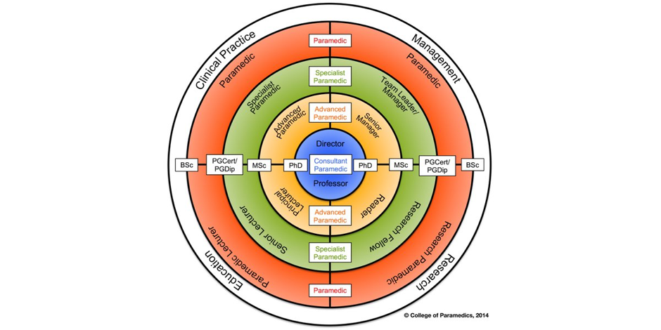
4 Pillars

Slide 22
Advanced Clinical Practice
• Decision making/clinical judgment and problem solving
• Critical thinking and analytical skills incorporating critical reflection
• Managing complexity
• Assessment, diagnosis referral, discharge
• Developing higher levels of autonomy
• Assessing and managing risk
• Prescribing (where required)
• Developing confidence
• Higher level communication skills
• Patient Focus/Public Involvement

Slide 23
Clinical /Professional Leadership
• Identifying need for change, developing rationale, leading innovation and managing change, service development
• Clinical Governance
• Equality & Diversity
• Ethical decision-making
• Developing case for change
• Negotiation and influencing skills
• Promoting and influencing others to incorporate values
based care into practice
• Networking - Team Development

Slide 24
Facilitating Learning
Principles of teaching and learning
• Supporting others to develop knowledge and skills
• Promotion of learning/creation of learning environment
• Service User/Carer teaching and information giving
• Developing service user/ carer education materials
• Mentorship and Coaching
• Building Capability and Capacity

Slide 25
Research and Development
• Ability to access research/use information systems
• Critical appraisal/evaluation skills
• Involvement in research/audit
• Ability to implement research findings into practice- including use of and development of policies/protocols and guidelines
• Conference presentations / Publications

Slide 26
Underpinning Principles of Advanced Practice Adapted from NES (2007)
Autonomous practice
  the freedom to exercise judgment about actions
  in turn accepting responsibility and being held to account for them
Critical Thinking
  explore and analyze evidence, cases and situations in clinical practice,
  enabling a high level of judgment and decision making

Slide 27
Underpinning Principles of Advanced Practice Adapted from NES (2007)
High Levels of Decision Making & Problem Solving
  Demonstrate expertise in complex decision making in relation to their current role
  Includes determining what to include in the decision making process, and making a decision based on judgment and critical thinking/problem solving
  In turn affects the ability to practice autonomously

Slide 28
Underpinning Principles of Advanced Practice Adapted from NES (2007)
Values Based Care
  At this level of practice ….a high level of awareness of their own values and beliefs
  Care is negotiated with patient/carers as an equal partner… ‘Working in a positive and constructive way with difference and diversity’’
  Putting the values, views and understanding of individual service users and careers at the centre stage
Improving Practice
  deliver practice which is evidence based within service, whilst acting as a positive role model that enables change regardless of their “job title”.

Slide 29
Expectations
Evolvement from 1st level nurse to Advanced level practitioner, from Paramedic to Specialist/Advanced Paramedic
High expectations – achievable, highly competent educated workforce
Proven substantive contribution across the sphere of Healthcare delivery and development
Challenges ALP – future vision level develops
debate governance and regulation

Slide 30
References
Advanced Nursing Practice Roles: Guidance for NHS Boards
Advanced Level Practice: Position Statement (2012)
NES Advanced practice tool kit https://www.google.co.uk/?gws_rd=ssl#q=NES+Advanced+practice+tool+kit
Scottish Government. Better Health Better Care (2007)
Shifting the balance of care (2009)

